Slide 1
Accounts solver

Slide 2
Team name : Task Breakers Team number : 29
Members:
Suvetha. B
Taniya joseph. J
Thirumurugan. N

Slide 3
Academic mentor : Mr. Rajasekaran
Industrial mentor : Ms. Subashini U

Slide 4
Problem statement :
A project for maintaining accounts developed by using python.

Slide 5
Accounting software
7 Accounting Formulas
1.Accounting Equation
2.Net Income
3.Break-Even Points
4.Cash Ratio
5.Profit Margin
6.Debt-to-Equity Ratio
7.Cost of Goods Sold

Slide 6
Assets = Liability + Owner’s Equity
Net Income = Revenues + Expenses
Break-Even Point = Fixed Costs / Sales Price – Variables Cost per unit
Cash Ratio = Cash / Current Liabilities
Profit Margin = Net Income / Sales
Debt-to-Equity Ratio = Total Liabilities / Total Equity
cost of Goods sold = Cost of Materials – Cost of Outputs

Slide 7
Abstract
The accounts solver is a python project which is used for accounting purposes business. The data were the user is prompted with choice of accounting calculations to select, based on the selection the user will give the input using GUI components and calculations were done based on the formulas and results will be displayed to the user . For example, If he chooses accounting equation the user is prompted to give two inputs which is liability( the debits of users) and the equity(the remaining of debit climbs) with respect to total assets and display to user . The computer results are taken for other operations too.
Notes:
1``````````````````````````````````````````````````````````````````````````````````````````````````````````````````````````````````````````````````````````````````````````````````````````````````````````````````````````````````````````````````````````````````````````````````````````````

Slide 8
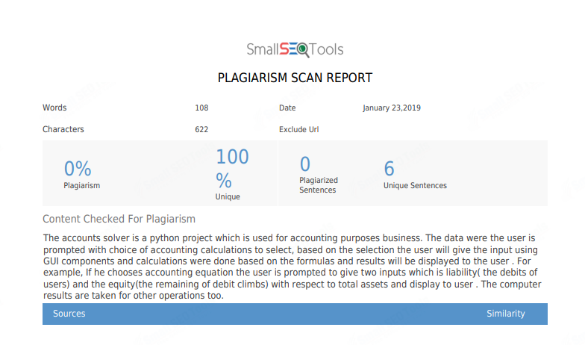

Slide 9
Module:
Home module
Selection module
Data Entry Module
Output Module

Slide 10
MODEL ARCHITECTURE
HOME
SELCTION SCREEN
INPUT FROM USER
OUTPUT
PROCESSING

Slide 11
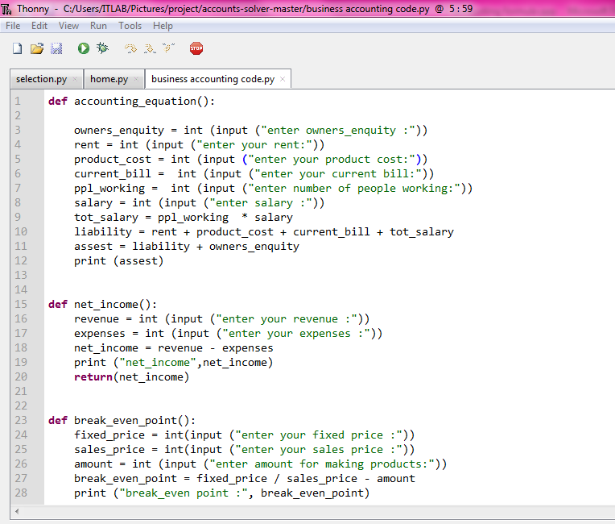
Sample code:

Slide 12
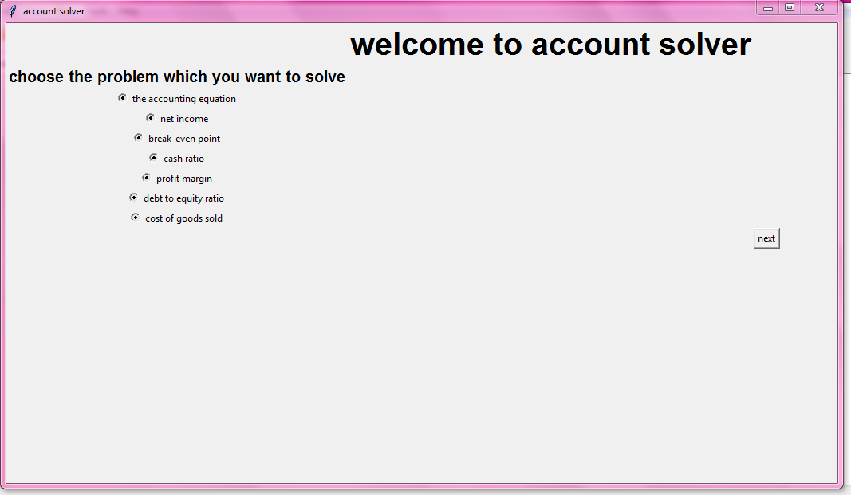
USER INTERFERENCE :

Slide 13
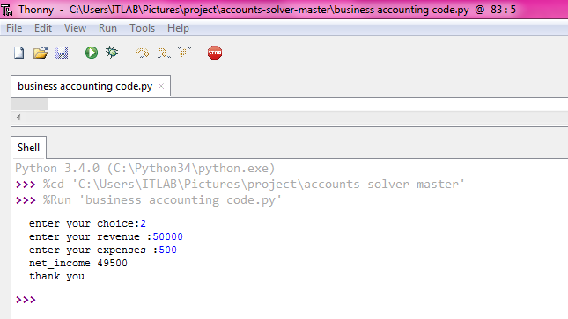
BACKEND RESULT :

Slide 14
MERITS :
Accounts solver can minimize the work of accountants.

Slide 15
REFERENCE :
https://www.google.com/search?q=7+accounting+formulas&oq=7+&aqs=chrome.0.69i59j69i57j69i60l3j0.3695j0j7&sourceid=chrome&ie=UTF-8
https://pythonprogramming.net/python-3-tkinter-basics-tutorial/
https://likegeeks.com/python-gui-examples-tkinter-tutorial/

Slide 16
THANK YOU

